Slide 1

Business Analytics & Predictive Modeling Project
Customer Churn Analysis & Retention Strategy
Prepared by
MD Afroz Ansari

Slide 2
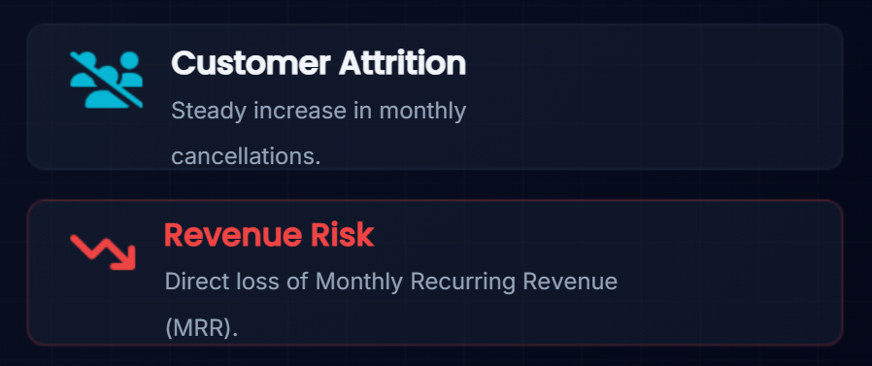
The Business Problem
Customer churn directly impacts our revenuepredictability and limits long-term business growth.
The company is experiencing a steady loss of customers over time.
We lack visibility into the exact drivers causing customer dissatisfaction.
There is a critical need to find high-risk accounts and
deploy targeted retention strategies.

Slide 3
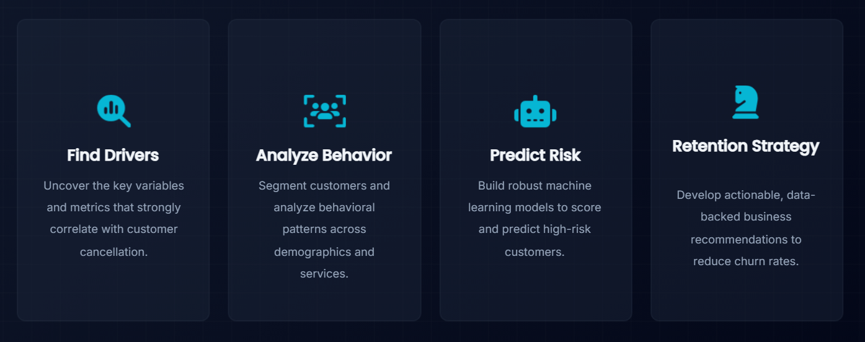
PROJECT OBJECTIVES

Slide 4
Dataset Overview
Key Variable | Data Type | Description
CustomerID | Categorical | Unique identifier
Tenure | Numerical | Months with company
Monthly Charges | Numerical | Current monthly bill
Total Charges | Numerical | Lifetime value billed
Contract | Categorical | Term (Mo-to-Mo, 1 Yr, 2 Yr)
Payment Method | Categorical | Billing medium
Churn | Target (Binary) | Yes/No
DATA SCALE
The analysis uses a comprehensive telecom dataset
having historical customer records.
DATA CATEGORIES
Demographics: Gender, Age, Dependents
Account Info: Tenure, Contract, Payment Method
Services: Internet, Phone, Streaming
7000+
Total Record's
21
Features

Slide 5
Data Cleaning & Preparation
Data Cleaning & Preparation : Imported raw customer database. Initial schema validation and type checking.
Data Cleansing: Handled missing values, Removed duplicates, Formatted Total Charges .
Analysis Ready : Cleaned, validated, and normalized dataset ready for EDA and modeling.

Slide 6
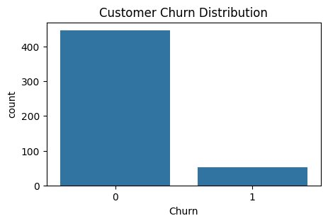
Customer Churn Distribution
KEY INSIGHTS
Approximately 26.5% of customers in the dataset have
Churned.
Most customers (73.5%) were successfully retained.
Despite being the minority, the churn volume represents a substantial risk.
BUSINESS IMPACT
Immediate Revenue Loss Risk
A baseline churn rate over 20% requires immediate, proactive retention strategies to stabilize MRR.

Slide 7
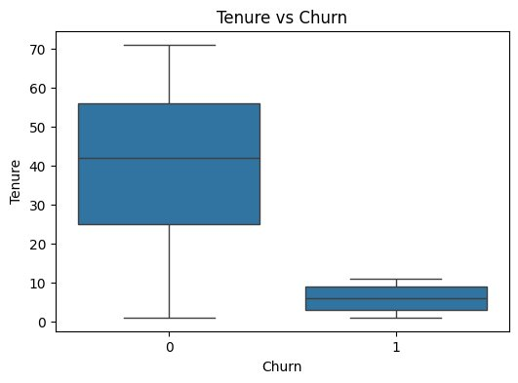
Tenure vs Churn Analysis
Key Insights:
Short-tenure customers show the highest probability of churning.
Long-term customers display significantly higher loyalty and lower churn rates.
The critical drop-off period occurs within the first 6 to 12 months.
Business Recommendation:
Focus on Early-Stage Experience
Retention efforts and onboarding support must be heavily prioritized for first-year customers to build long-term loyalty.

Slide 8
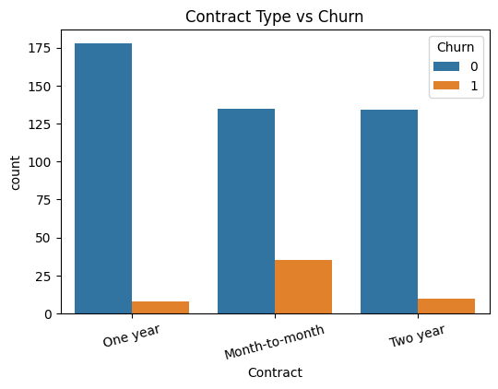
Contract Type Analysis
Key Insights:
Month-to-month customers show a disproportionately high churn rate.
1-Year and 2-Year contracts drastically improve retention metrics.
Contract structure is a primary behavioral indicator of future loyalty.
Business Recommendation
Incentivize Annual Subscriptions
Deploy promotional pricing or exclusive features to migrate month-to-month users onto stable, long-term contracts.

Slide 9
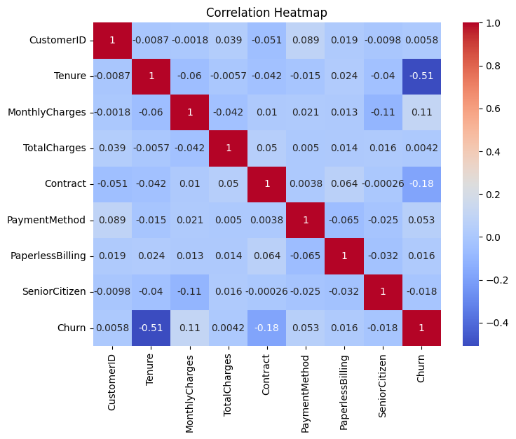
Correlation Heatmap Analysis
Executive Insights:
Tenure Correlation (-0.35)
Tenure is strongly negatively correlated with churn, confirming loyalty increases over time.
Monthly Charges (+0.19)
Higher monthly charges slightly increase the probability of churn, showing price sensitivity.
Contract Duration
Long-term contracts show strong negative correlation with churn, acting as a retention anchor.

Slide 10
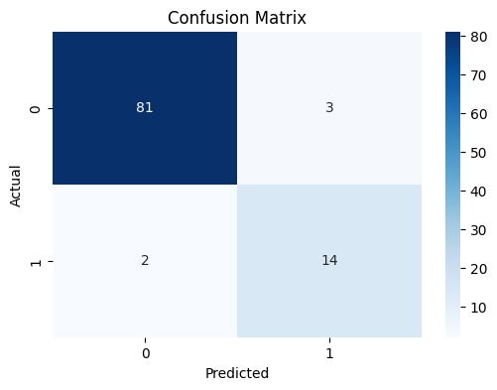

Predictive Modeling Workflow
Machine Learning Approach: Implemented Logistic Regression to predict binary churn outcomes based on historical feature inputs.
Train / Test Split:
80% Training Data | 20% Evaluation Data
Model Training:
Logistic Regression / Random Forest fitted
Evaluation:
Measuring Accuracy, Precision, and Recall

Slide 11
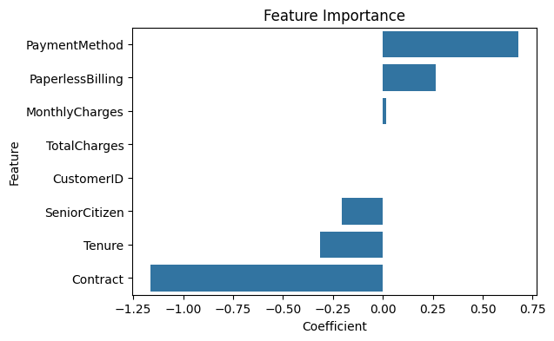
Feature Importance Analysis
Key Predictive Drivers
Tenure acts as the strongest overall predictor of customer retention.
Contract Type heavily influences whether a customer will leave.
Monthly Charges drive price-sensitive churn behavior.
Business Value Delivered
Predictive Targeted Interventions
By understanding feature importance, the business can deploy algorithms to flag high-risk customers in real-time before they cancel.

Slide 12

Business Recommendations
Loyalty Programs
Implement tiered reward programs specifically targeting customers in the critical 6–12-month tenure window to build habituation.
Contract Discounts
Offer strategic discounts or upgraded service tiers to month-to-month customers who agree to sign 1-year or 2-year contracts.
High-Risk Monitoring
Deploy the predictive ML model into a live dashboard for customer service agents to identify and engage high-risk accounts.
Better Onboarding
Revamp the day-1 to day-30 onboarding experience to ensure customers are fully utilizing services, preventing early attrition.

Slide 13

Expected Business Impact
Implementing these data-driven retention strategies will yield measurable organizational benefits.
Reduced Churn
Lower overall attrition rate
2. Increased Retention
Higher customer lifetime value
3. Better CSAT
Improved satisfaction scores
4. Revenue Protected
Secured recurring revenue

Slide 14

Conclusion
Any Questions?
Data analytics successfully found major behavioral and billing churn drivers.
Predictive modeling now supports proactive, targeted business decisions.
Implementing targeted retention strategies will secure MRR and improve long-term growth.

Slide 15


